Slide 1

PREDICTING CORPORATE BANKRUPTCY
FINAL PRESENTATION
Group – 4
Akshay Kumar | Avi Mudgal | Manasi Sardesai | Manoj Kumar | Shivaraj MS | Shilpa MS

Slide 2
Table of Contents
Problem Statement
Project Development Stages
Introduction to Classification Methods
Dataset Information
Data Preprocessing & EDA
Feature Engineering
Model Building
Model Evaluation
Deployment
Challenges & Future Scope

Slide 3
Problem Statement
Develop a classification model that predicts the likelihood of a company getting bankrupt or remain solvent. Build various classifiers and select the best model based on the performance metrics.
Real-world applications:
Identify at-risk companies, critical insights to stakeholders.
Enables early intervention and risk management.
Determines key financial factors critical to a company’s success.

Slide 4
Project Development Stages
Data Collection
Cleaning & Preprocessing
EDA & Feature Engineering
Model Building
&
tuning
Model Evaluation
Deployment

Slide 5
Introduction to Classification Methods
Machine Learning: A subset of AI, enables a system to learn from data and make predictions or decisions.
Classification Methods: A supervised machine learning technique, models trained over labelled dataset, used to predict a categorical label or class based on input features.
Example: Logistic Regression, Decision Trees, KNN, SVM, etc.
Ensemble Methods: Techniques used to improve the performance of classifiers, usually learns from multiple models and combines them into one.
Example: Random Forest, Naïve Bayes, Boosting and Bagging, etc.

Slide 6
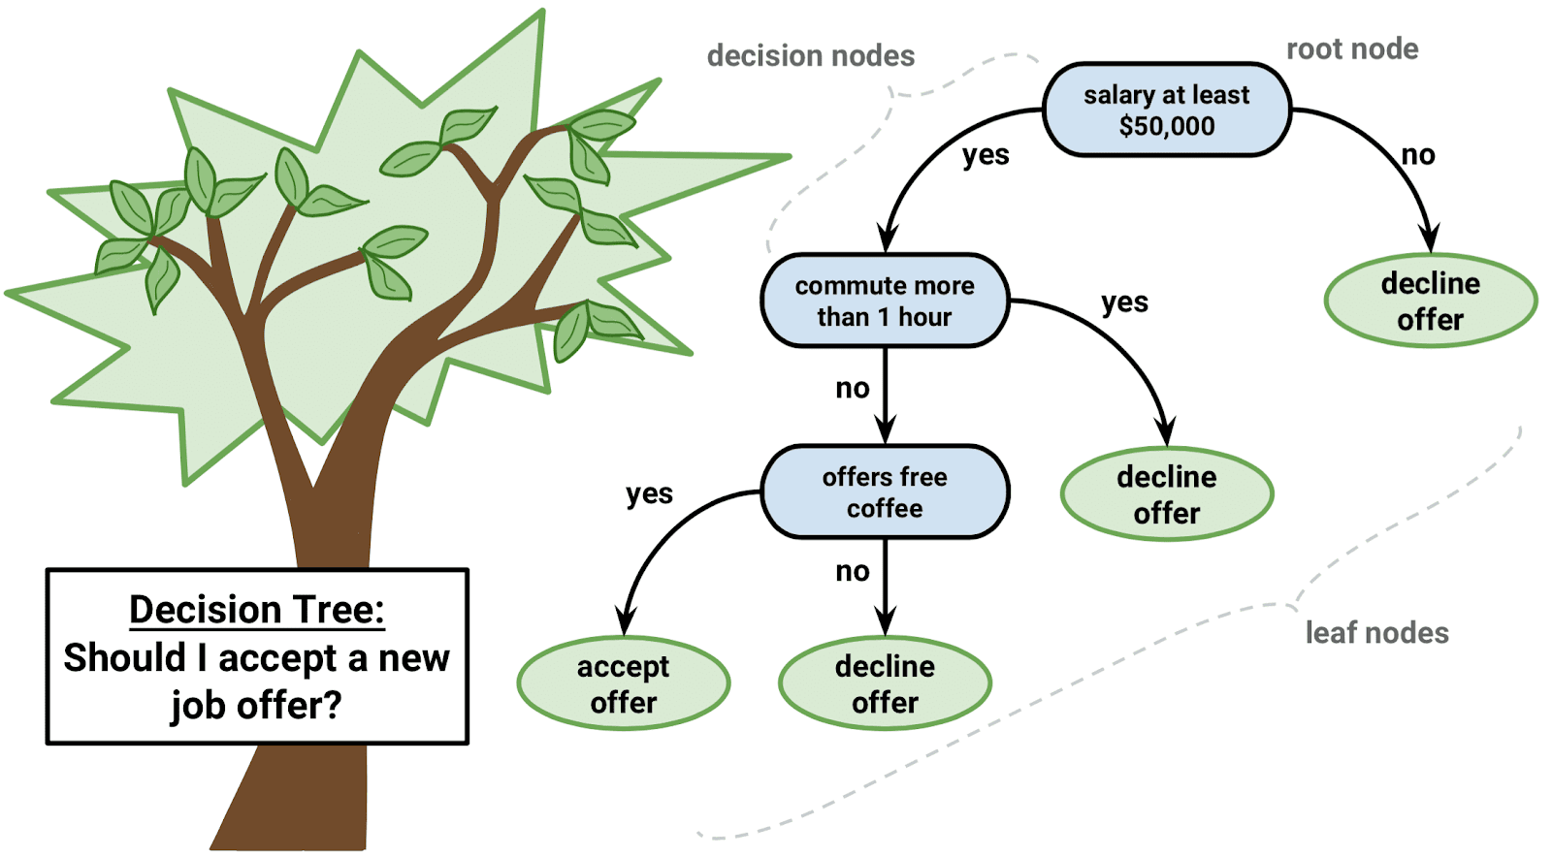
Decision Trees
An algorithm that resembles a tree or flowchart-like structure.
Each internal node represents a test on an attribute.
Each branch represents the outcome of the test.
Each leaf node represents a class label or decision.
Working: Start the root node > Splitting > Create child nodes > Repeat
Split is chosen based on maximising information gain or Gini impurity reduction.
Sometimes may overfit the data
Python: from sklearn.tree import DecisionTreeClassifier

Slide 7
Dataset Information
Dataset contains financial information for companies listed on the Taiwan Stock Exchange from 1999 to 2009.
Number of Features: 95 (X₁ to X₉₅)
Number of Targets: 1 {Y: “Bankrupt?”, Class Label: (1 = Bankrupt, 0 = Solvent)}
Number of Records: 6800+

Slide 8
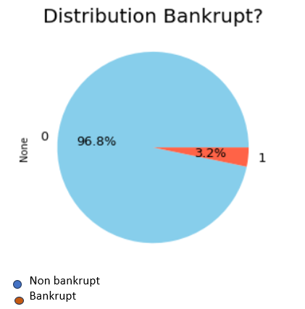
Data Preprocessing & EDA
Check for null values and duplicates.
Drop duplicates (if any) and treat null values by dropping or imputation methods.
Detect data types of all columns: All are numerical features.
Check bankruptcy class distribution.

Slide 9
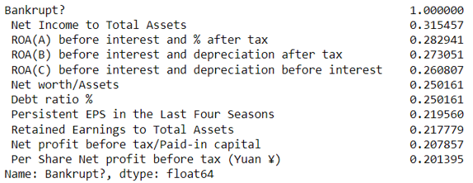
Data Preprocessing & EDA
Determine Top 10 features most correlated to the target using Correlation Matrix.

Slide 10
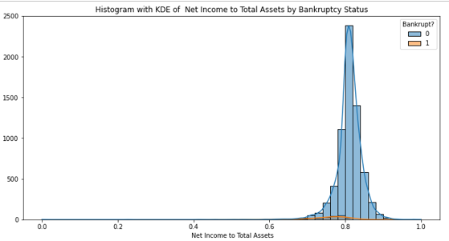
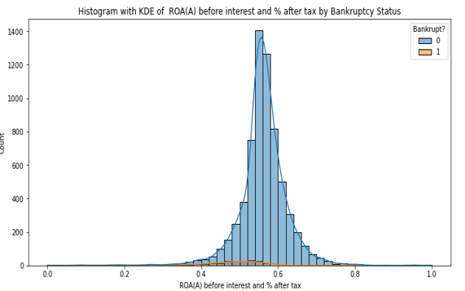
EDA Visualizations
Histogram plots of Top 2 Features

Slide 11
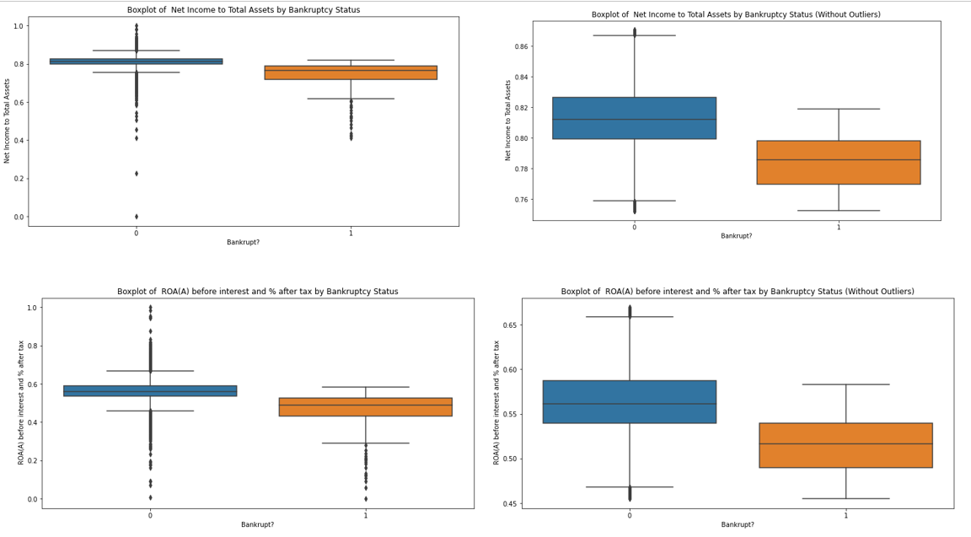
EDA Visualizations
Box plots of Top 2 Features (With and Without Outliers)

Slide 12
Insight on Features:
Net Income to Total Assets: The mean increased slightly, and the standard deviation decreased, indicating a more consistent measure of profitability relative to total assets.
ROA (Return on Assets): Similar improvements are observed, indicating a more reliable measure of profitability after removing outliers.

Slide 13
Feature Engineering
Crucial step before model building.
Transform features via encoding or scaling methods.
For this dataset, used StandardScalar to normalize all numerical features.
Outliers were treated by removing them using ensemble technique IsolationForest.

Slide 14
Model Building
Objective is to not only find the best model for deployment, but also ensure the effect of outliers over the quality of results.
Separated data into features (use Top 10) and target and performed StandardScalar normalization.
Split into training and testing set. (test size = 0.2, random state = 42)
Built various classifiers: Logistic regression, Decision trees, Random forest, Naïve bayes, SVM, xgBoost, Gradient boosting, Adaboost.
Included hyperparameter tuning to identify best model from each algorithm.
Calculate evaluation metrics for each model (Accuracy, Precision, Recall, F1-score).

Slide 15
Model Building
Dataset without Outliers:
Remove outliers from dataset using IsolationForest.
Assume different contamination rates: 0.01, 0.05, 0.1, 0.15, 0.2
Repeat the same steps for all contamination rates.
Compared the evaluation metrics for all the models at different contamination rates.
Also, compared them with the metrics calculated for original dataset.

Slide 16
Model Evaluation
Types of evaluation metrics performed:
Accuracy score: Measures the proportion of correctly predicted instances among total instances.
Precision: Ratio of true positive predictions to the total predicted positives.
Recall: Ratio of true positive predictions to the actual positives.
F1-score: Harmonic mean of precision and recall.
FINAL MODEL RESULTS
Model: Decision Trees over dataset without outliers
Contamination Rate: 1%
Metrics: Accuracy = 95%, Precision = 29%, Recall = 27%, F1-score = 28%
Precision and recall less, but seen relatively balanced compared to all models at different contamination rates.

Slide 17
Deployment
Final model deployed using Streamlit.
User Interface:
Input for Company Name
Input fields for each feature (only Top 10)
Predict button to display prediction result
Refresh button to clear all inputs

Slide 18
Challenges
Data Quality
Handling outliers
Ensuring data consistency and reliability
Model Complexity
Balancing between overfitting and underfitting
Choosing the right hyperparameters
Deployment
Ensuring real-time prediction capability
User-friendly interface for non-technical users

Slide 19
Future Scope
Model Improvement
Explore more on ensemble techniques (Random forest, xgBoost)
Incorporate more features for accuracy
Employ resampling methods to remove bias
Scalability
Deploy model on cloud platforms for better accessibility
Ensure the model can handle large datasets effectively

Slide 20

Thank You!

